Slide 1


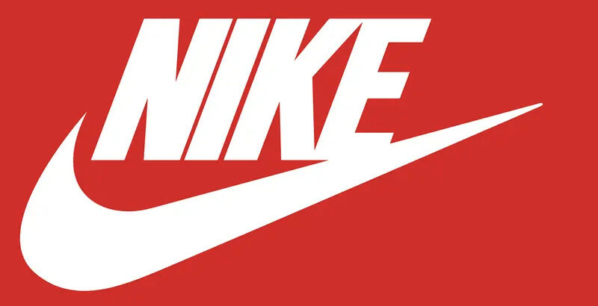

ACT ADVISING
OCTOBER 2025 |
Case Study
Angelina Ponce, Chelsea Oliveira, Tahjarie Edwards
From Just Doing It… to Doing It Better, Together

Slide 2
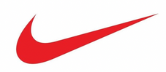







Agenda
Company Background
Issue Overview
Recommendations
Implementation Plan
Risks & Mitigation
ACT Consulting Inc.
Financials
Key Performance Indicators
1

Slide 3
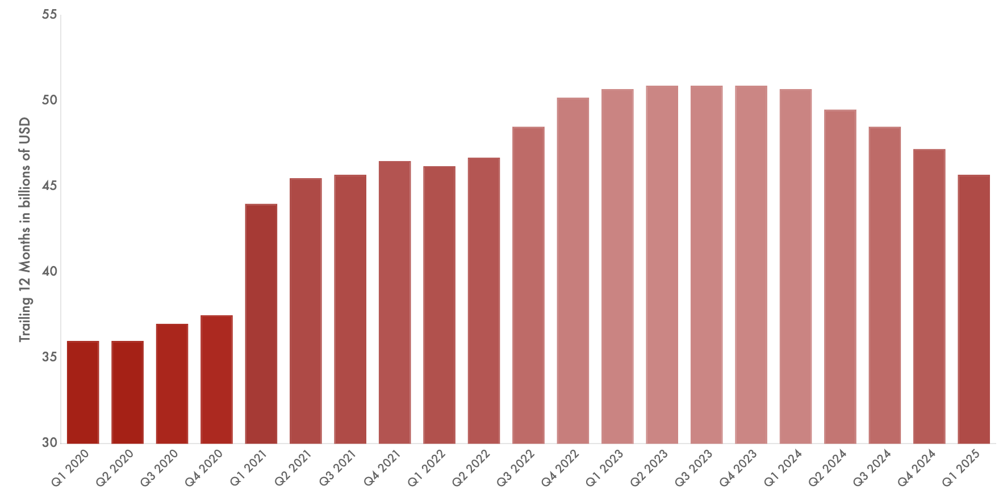
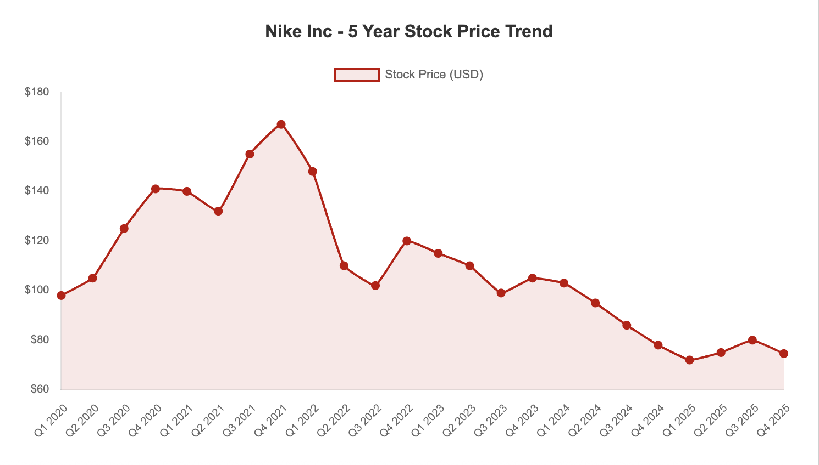
Company Background – Nike
General Overview
Stock Price Activity
World’s largest sportswear company
Ticker: NKE (NYSE)
Business Segments
Footwear (~60% of revenue)
Apparel (~30%)
Equipment & Accessories (~10%)
5-year trend: Peaked ~$170B in late 2021 → ~$90–100B (2025)
Sales slowdown, promotional pressure, digital ecosystem challenges
Revenue – 5 Year Period
Investors focused on brand reinvention and restoring growth margins
Trend: High growth in digital/DTC, but recent flat to declining revenue amid consumer demand slowdown
Stock Prices – 5 Year Period
ACT Consulting Inc.
2

Slide 4




Issue Overview – A Direct Disconnection
Nike’s core challenge is a weakening connection with consumers, driven by gaps in its digital ecosystem and brand positioning.
Digital Experience Gaps
Competitive Pressure
Decreasing Customer Loyalty
Brand Identity Dilution
ACT Consulting Inc.
Nike has fragmented App Experience across SNKRS, Run Club and main store
Rivals currently outperform Nike with better innovation and stronger loyalty ecosystems
Due to a lack of deeper engagement, operational efficiency struggles to sustain revenue growth
Nike has abandoned its performance-first heritage, leaning into fashion trends
3

Slide 5
Recommendation Overview
1
Rebuild Consumer Connection
2
Strengthen Digital Ecosystem
3
Enhance Omni-Channel Integration
4
Refocus on Performance Heritage
ACT Consulting Inc.
4

Slide 6
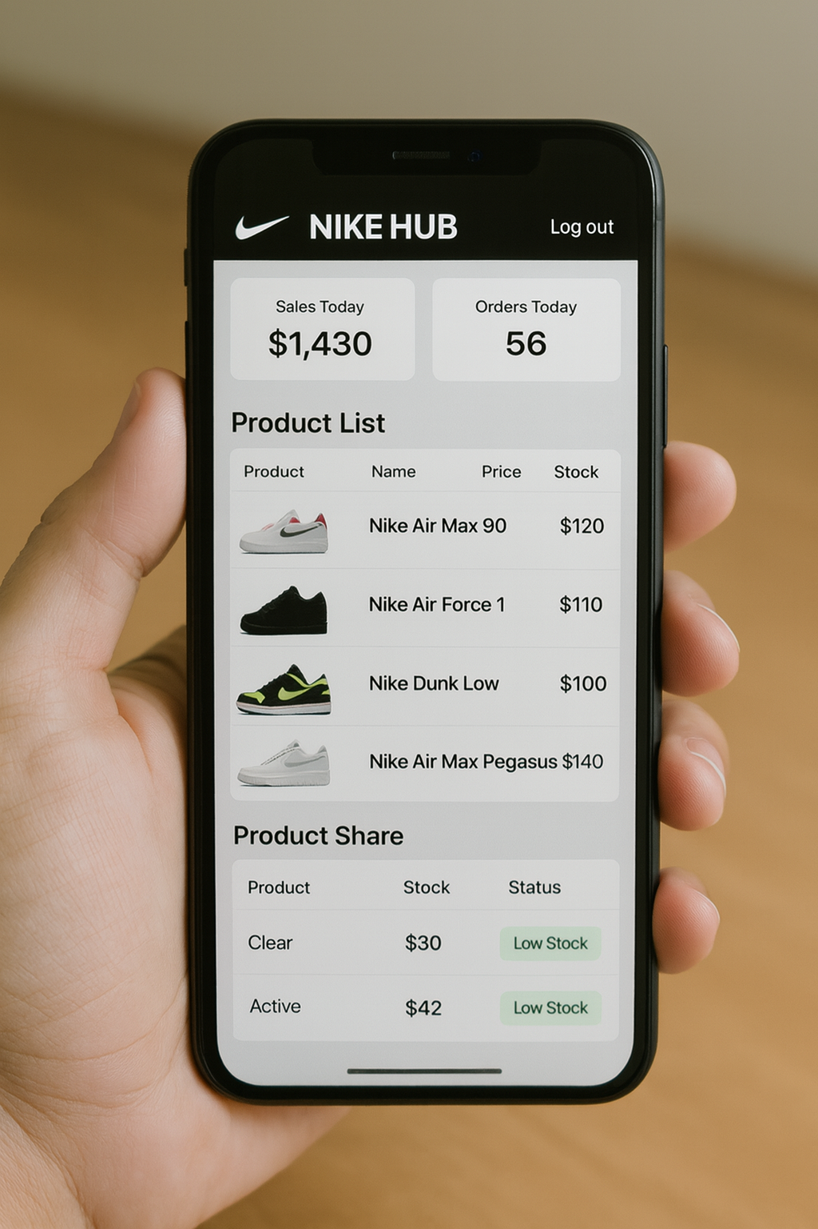
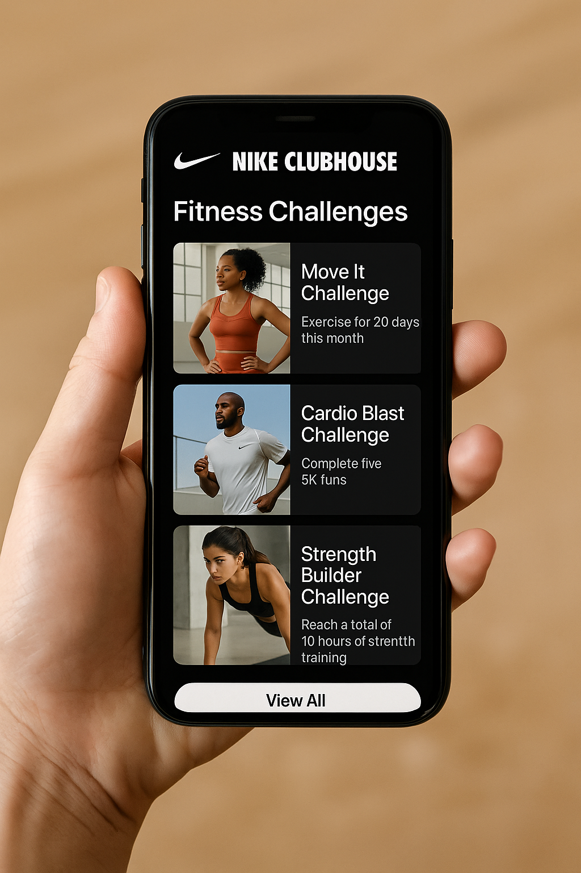
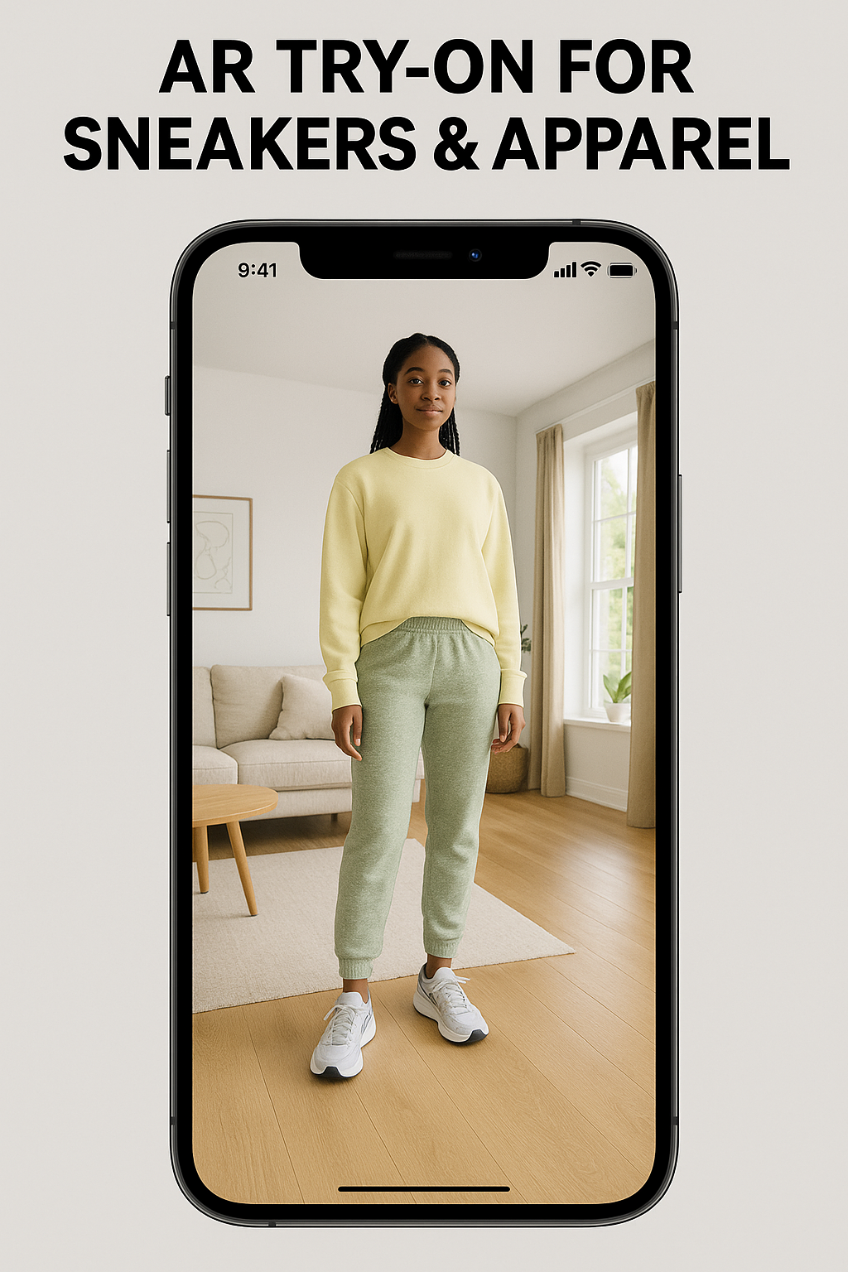
1: Rebuild Consumer Connection
Make Every Click Personal
Personalized Nike app & site
AR/AI try-ons for sneakers & apparel
“Nike Clubhouse”: fitness challenges + early drops
ACT Consulting Inc.
5

Slide 7


2: Strengthen Digital Ecosystem
Nike+ 2.0: From Membership to Movement
Tiered loyalty program
Exclusive collabs & content
Points for purchase + activity
Silver- Free shipping, early sale access
Gold- Points multiplier, training content
Platinum- VIP collab access + event access
Earn rewards for both shopping and workouts
Encourages daily engagement and lifestyle integration
Earn rewards for shopping and workouts
Encourages daily engagement and lifestyle integration
ACT Consulting Inc.
6

Slide 8



3:Enhance Omni-Channel Integration
Seamless Journeys Everywhere
Seamless Shopping
Customer Benefits
Real-Time Inventory
Expand BOPIS (Buy Online, Pick up In Store)
Unified cart across app, site, and stores
Live product availability by location
Smarter distribution = fewer stockouts & overstocks
Convenience + flexibility = stronger loyalty
Smooth digital-to-store journey keeps Nike top of mind
ACT Consulting Inc.
7

Slide 9



4: Refocus on Performance Heritage
Back to Sport, Forward to Culture
Sport-First Storytelling
Brand Benefits
Heritage Relaunches
Athlete-led campaigns that spotlight innovation
Shift narrative back to performance, not just fashion
Relaunch of heritage silhouettes to promote performance first
Engages culture
Balance fashion collabs with sport innovation
Restore “obsession with sport”
ACT Consulting Inc.
8

Slide 10
Implementation
A single, integrated "Nike Hub" that centralizes the user experience, from shopping and content to community and fitness tracking
Implement predictive analytics for demand forecasting and inventory management, reducing waste and ensuring product availability
Leverage AI to deliver individualized product recommendations, content, and loyalty rewards based on user behavior and preferences
ACT Consulting Inc.
9

Slide 11

The 18-Month Race
Make Every Click Personal
Months 1-6
Months 7-12
Months 13-18
Integration
Optimization
Foundation
Integration
Optimization
A public launch of the "Nike Hub." Rollout of the AR Try-On and community features. AI involvement for inventory management.
A public launch of the "Nike Hub"
Rollout of the AR Try-On and community features AI involvement for inventory management
Develop and pilot the core "Nike Hub" platform Begin AI model training for personalization and supply chain forecasting
Refine AI algorithms based on live data
Expand personalized offerings and scale experiential retail concepts
ACT Consulting Inc.
10
Notes:
Estimated Investment: $[150-200M] | Projected ROI: Positive within 24 Months
Investment allocated primarily to cloud infrastructure (40%) and specialized AI talent (60%).

Slide 12


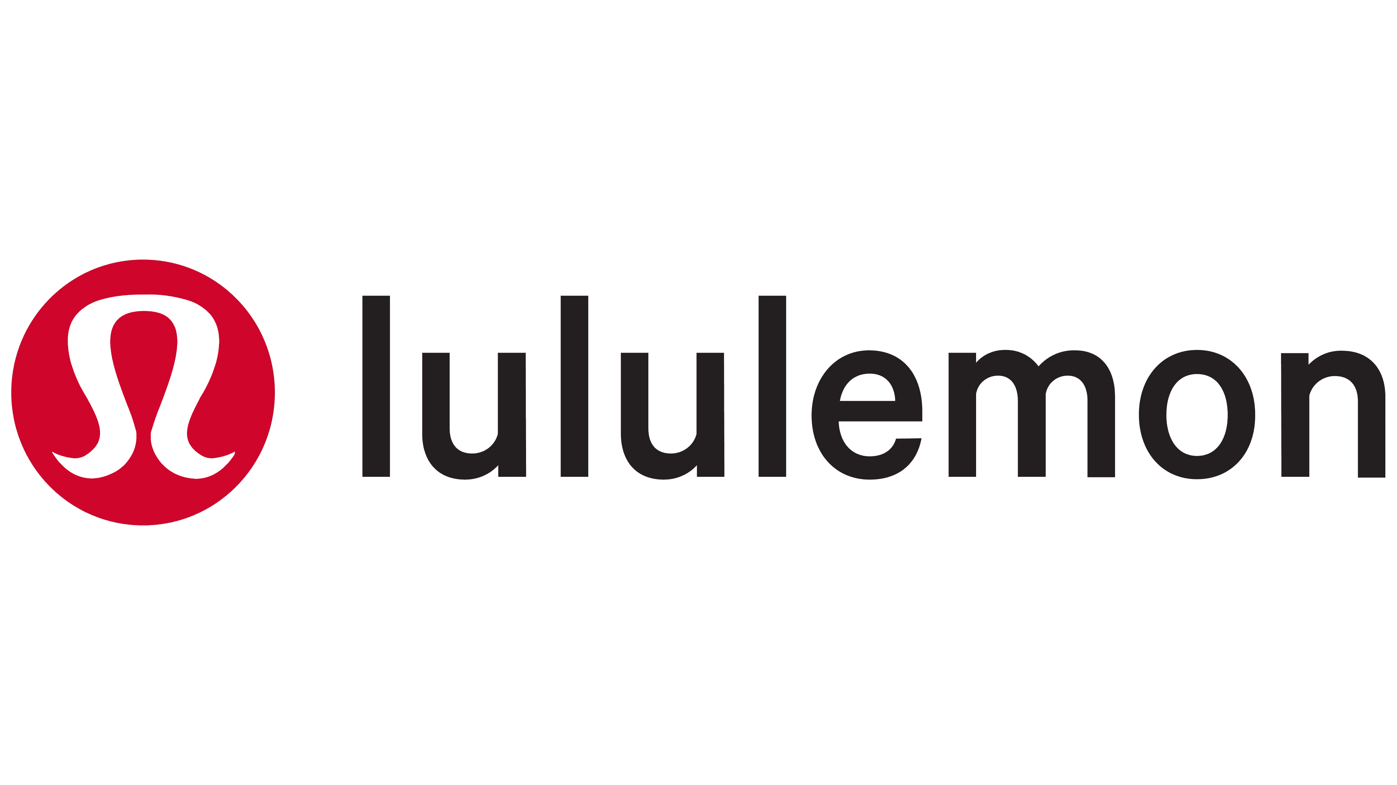
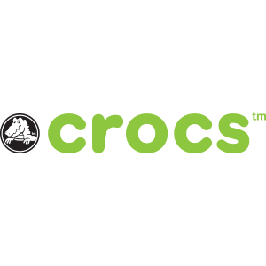





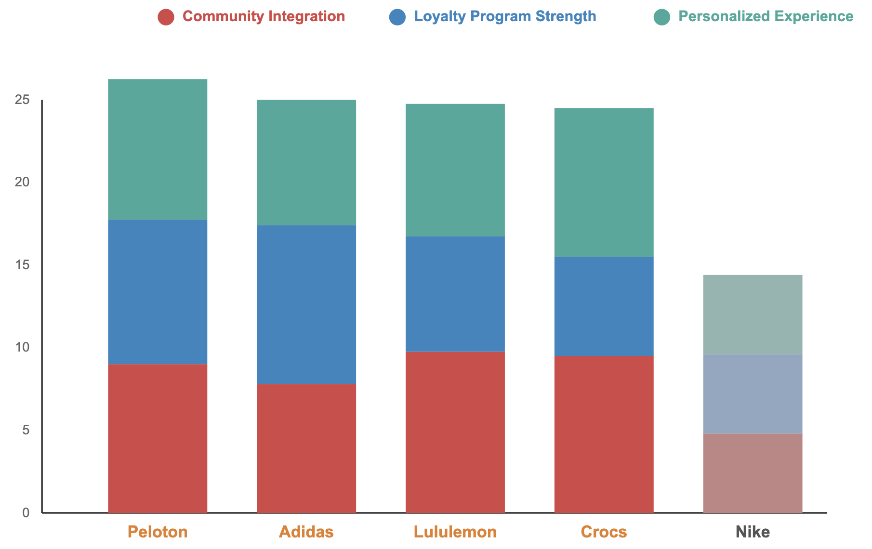
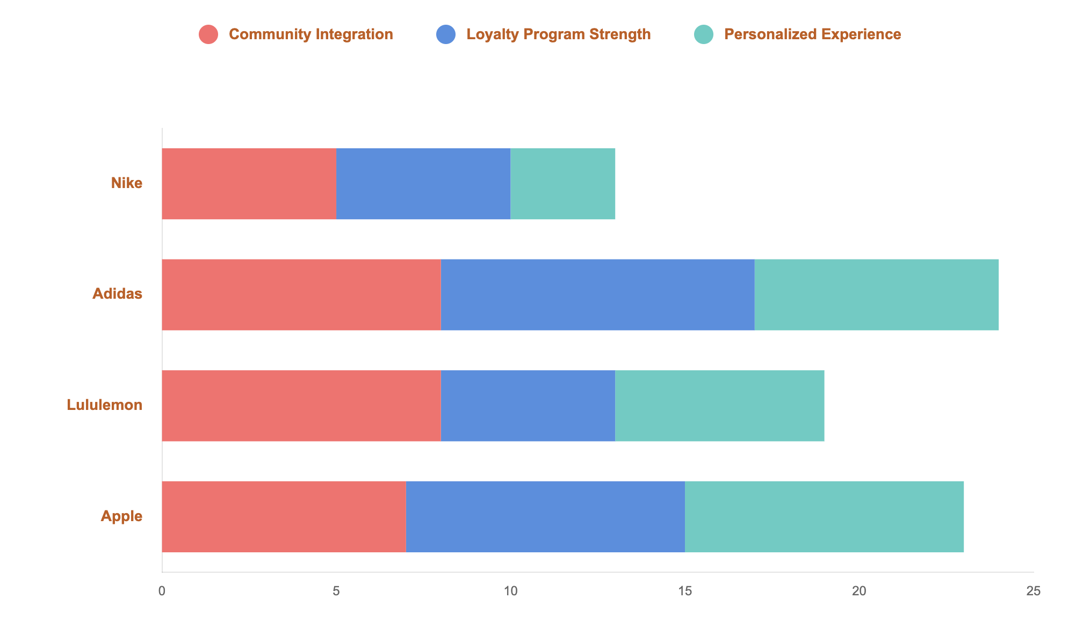
Analyzing The Competition
Community Integration
Personalized Experience
450+ stores host classes; drives 0% churn and makes 65% of customers feel brand-connected
Generates $260M Jibbitz revenue (6% of total) with 80% YoY digital growth proves customers pay premium for personalization
Celebrity collaborations sell out in 16-90 minutes and trigger 13% stock jumps, building "Croc Nation"
AI analyzes 22 workouts/month per user w/ biometric data, achieving 60% adoption of personalized Pace Targets feature on Tread
Leverages 13.87M instructor-followers to drive 60% lower churn for members engaging with multiple disciplines monthly
50% loyalty increase via personalized workouts and ambassador recommendations integrating fitness classes with e-commerce
Fitness app tracks w/o real-time community connection; Creators Club reward transactions over daily member engagement
ColorIQ matching, personalized Hype Access, and omnichannel integration; no deep customization or biometric data
Disconnected apps (Run Club/Training Club) not integrated into retail, no in-store events, and transactional-driven stores
No AR try-on technology, no AI-powered diagnostics, no biometric integration, and basic recommendations
Loyalty Program Strength
ACT Consulting Inc.
AdiClub: 2X lifetime value and purchase 50% more often than non-members through gamified four-tier system with Runtastic integration
Has industry-leading 90% year-1 retention and NPS > 70 across all products through Club Peloton's 11-level gamification
50% increased loyalty via Mirror integration and Sweat Collective (25% discounts); no points-based structure
Strong behavioral loyalty: 5X revenue growth from $847M to $4.1B and repeated collaboration sell-outs w/o a loyalty program
DTC sales falling 14% and no published data showing premium spend multiplier or retention rates beyond transactional benefits
11
Notes:
While Nike is an industry giant, key competitors have carved out distinct advantages in the digital space. By integrating community, loyalty, and seamless retail experiences, they are setting new consumer expectations. Nike must innovate to not only catch up but leapfrog these specialized strategies.

Slide 13




Brand Inspiration
Operational Efficiency
& Data Utilization Leader
Loyalty Program Strength Leader
Gamified mobile rewards with personalized offers, star system driving visits, and order-ahead integration
World-class supply chain efficiency with predictive analytics for demand forecasting
Customer data utilization creates highly accurate product recommendations
Real-time inventory management across distribution centers
One-click purchasing and seamless checkout experience
Rewards members show higher lifetime value through increased mobile orders and repeat purchases
Mobile-first approach reduces friction by integrating digital convenience with physical stores
Personalized Experience Leader
Community Integration & Omnichannel Excellence Leader
ColorIQ technology provides personalized foundation matching across skin tones
Retail + digital synergy with in-store personalization mirroring online experience across unified ecosystem
Community spaces and cultural moments via Genius Bar sessions and product launches driving loyalty beyond transactions
Product launches create cultural moments generating anticipation and ecosystem lock-in
ACT Consulting Inc.
AR Virtual Artist tool enables try-before-buy for makeup products
Beauty Insider program integrates personalized product recommendations with omnichannel shopping
Lacks deep biometric integration or community features beyond transactional benefits
12
Notes:
While Nike is an industry giant, key competitors have carved out distinct advantages in the digital space. By integrating community, loyalty, and seamless retail experiences, they are setting new consumer expectations. Nike must innovate to not only catch up but leapfrog these specialized strategies.

Slide 14
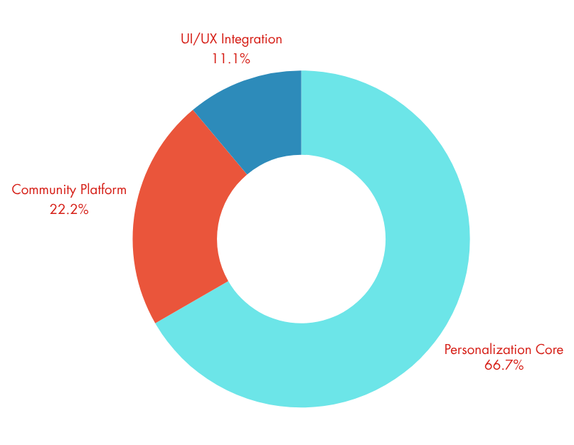
Deep Dive: The Nike Hub Ecosystem
The Nike Hub will be the cornerstone of the new digital strategy.
Personalization Core (66.7%)
AI-powered foundation delivering individualized experiences based on purchase history and activity data; customized training content for individual fitness goals and dynamic homepage personalization
Community Platform (22.2%)
Transforms Nike from transactional to lifestyle hub through Nike Clubhouse fitness challenges, virtual events with athletes and influencers, and social features rewarding engagement beyond purchases
ACT Consulting Inc.
UI / UX Integration (11.1%)
Seamless omni-channel navigation with unified cart across app/website/stores, real-time inventory visibility, and friction-reducing intuitive design
Mirrors Apple's mastery of in-store personalization seamlessly reflecting online experience across all customer touchpoints
13
Notes:
We will consolidate all fragmented apps (SNKRS, NRC, main store) into a single, seamless Unified Nike Hub.
Core Feature: Integration of AR Try-On and virtual fit technology to directly address the emotional pain point (uncertainty).
The Goal: Leverage AI to deliver truly individualized recommendations, content, and loyalty rewards.

Slide 15
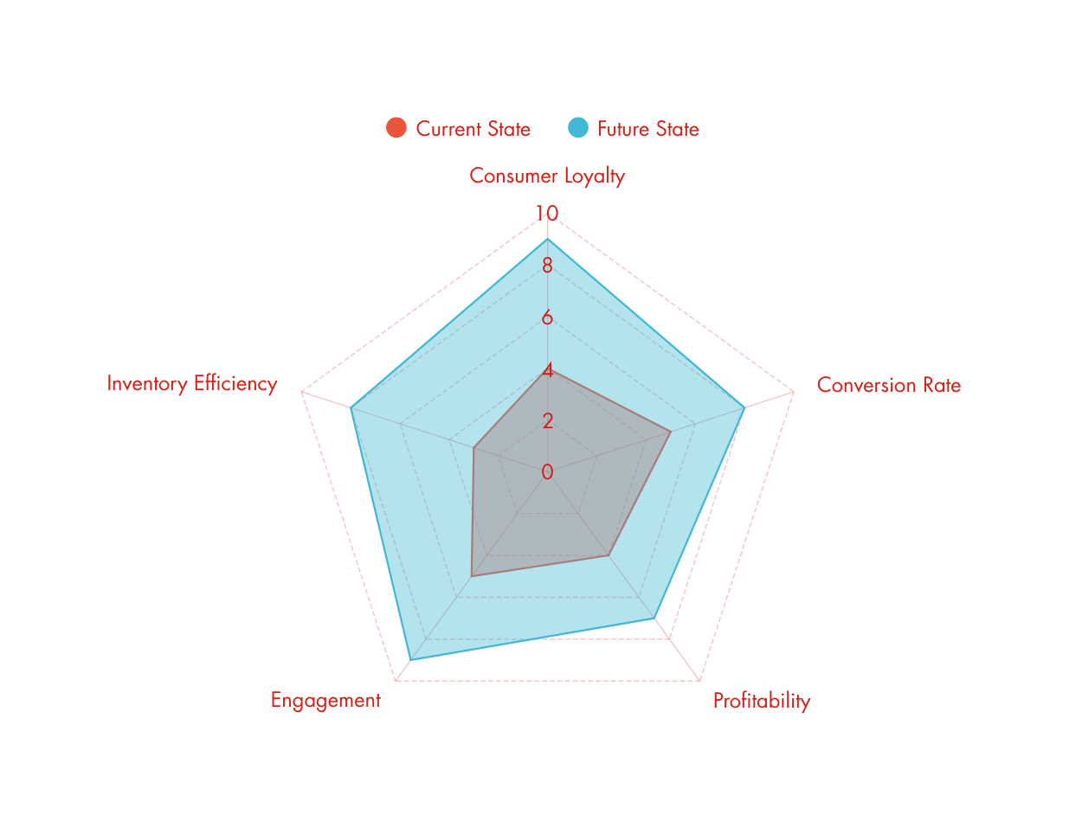
Projected KPI Improvements
Consumer Loyalty
Increases 3/10 → 9/10 - via Nike+ 2.0's tiered program, points for purchases + activities, and exclusive content
Addresses current weakness where Nike scores lowest among competitors with DTC sales falling 14% and no published premium spend multiplier data
Conversion Rate
Increases 4/10 → 8/10 through personalized recommendations, AR try-on reducing purchase hesitation, and seamless omni-channel shopping - closing gaps vs. Sephora's ColorIQ and Crocs' personalization ($260M Jibbitz revenue, 6% of sales)
Profitability
ACT Consulting Inc.
Increases 2/10 → 7/10 through reduced promotional pressure via stronger brand connection, AI forecasting preventing inventory build-up, and higher customer lifetime value from recurring engagement versus one-off purchases
Inventory Efficiency
Engagement
Increases 4/10 → 8/10 through predictive analytics for demand forecasting, real-time inventory visibility across channels, and smarter distribution reducing stockouts and overstocks—addressing Nike's documented supply chain and inventory build-up challenges
Increases 2/10 → 7/10 through reduced promotional pressure via stronger brand connection, AI forecasting preventing inventory build-up, and higher customer lifetime value from recurring engagement versus one-off purchases
14
Notes:
This strategy is projected to drive dramatic improvements across key metrics within 24 months:
Customer Loyalty (CLV): Projected score from 4 to 9 (out of 10).
Conversion Rate & Brand Engagement: Strong increases driven by purchase confidence and community.
Inventory Efficiency: Significant gains from predictive AI (score 3 to 8).

Slide 16



Proactive Risk Management
A bold technological transformation requires a robust risk mitigation strategy
Data Privacy & Cybersecurity
Technology Adoption
Implement end-to-end encryption and invest in advanced threat detection
Provide comprehensive upskilling and training programs for the workforce in data analytics and digital customer service
Supply Chain Disruptions
ACT Consulting Inc.
Build redundancy with diversified sourcing and regional distribution centers
15
Notes:
Implement end-to-end encryption and invest in advanced threat detection. To ensure full compliance with global regulations like GDPR & CCPA through transparent user consent policies.
Build redundancy with diversified sourcing and regional distribution centers. Using predictive AI demand forecasting to prevent inventory buildup and enable smarter, more agile distribution.
Provide comprehensive upskilling and training programs for the workforce in data analytics and digital customer service. Launch phased rollouts to gather feedback and ensure smooth transitions.

Slide 17

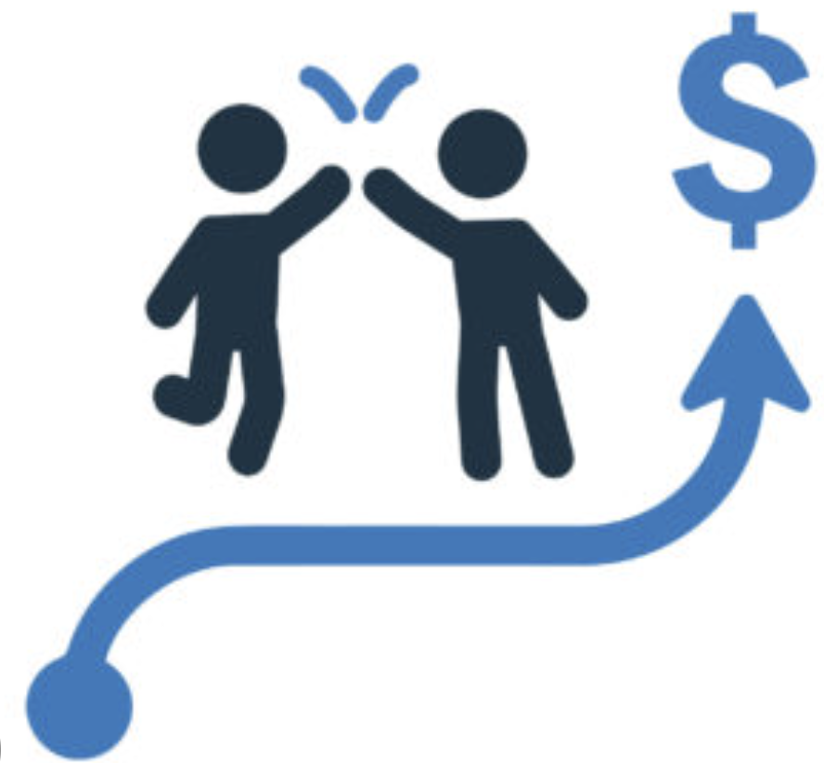


Impact & Change Management
Managing change across the organization is crucial for successful integration
Customers
Stores
Increased trust, loyalty, and purchase confidence via hyper-personalized, seamless experiences
Transition to hybrid retail: fewer but more experiential flagship stores, digitally integrated with the Hub
Workforce
Supply Chain
ACT Consulting Inc.
Upskilling in data analytics and digital commerce; transparent communication and training are mandatory
Improved efficiency and reduced surplus via AI-enabled, precise demand planning and agile distribution
16
Notes:
Implement end-to-end encryption and invest in advanced threat detection. To ensure full compliance with global regulations like GDPR & CCPA through transparent user consent policies.
Build redundancy with diversified sourcing and regional distribution centers. Using predictive AI demand forecasting to prevent inventory buildup and enable smarter, more agile distribution.
Provide comprehensive upskilling and training programs for the workforce in data analytics and digital customer service. Launch phased rollouts to gather feedback and ensure smooth transitions.

Slide 18
Appendix Overview
Nike, Inc. – Accelerating a Consumer-Led Transformation to Ignite Growth
Nike’s New Business Model Focusing on DTC — Nexford University
Nike Digital Transformation: Real Examples (2025) — Golden Owl
Nike – Digital Transformation Strategies
The Spaces Where Nike Creates the Future of Sport — Nike Newsroom
Nike Innovation
The Role of Technology in Mitigating Supply Chain Disruption
The Cost of Momentum: Adidas’s Bold Marketing & E-commerce Strategy — Business of Fashion
Adidas Digital Marketing Strategy & Campaigns — Think with Google
Lululemon Appoints AI-Focused Executive in Newly Created Role — Retail Dive
Lululemon Embraces AI to Accelerate Design & Go-to-Market — PYMNTS
Our Unique Proposition — Lululemon Corporate
Top 9 AI Fashion Design Software in 2025 — NewArc.ai
Top 10 AI in Fashion: Use Cases & Examples — Forbes
Revolutionary AI for Supply Chains: 5 Uses — Retalon
11 Best AR eCommerce Examples — Dri blog
10 Best AR/VR in eCommerce — Threekit
Customer Connection Guide — Salesforce ANZ
What is Customer Connection? — HubSpot
Automated Data Security & Compliance for Retail — BigID
7 Retail Data Privacy Mistakes — RetailWire
The Impact of Cybersecurity on eCommerce Fulfillment
ACT Consulting Inc.
17

